Slide 1
Generation of Electricity by Waste
Presented By : Vivek Rawat & Pranay Sharma
BSA College of Engineering & Technology , Mathura

Slide 2
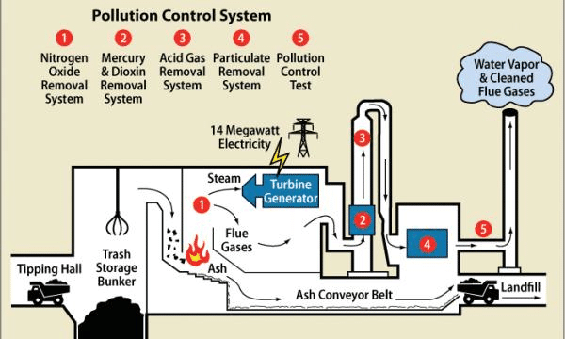
INTRODUCTION
Electricity generation from waste refers to the process of converting various types of waste materials into electrical energy through different technologies.

Slide 3
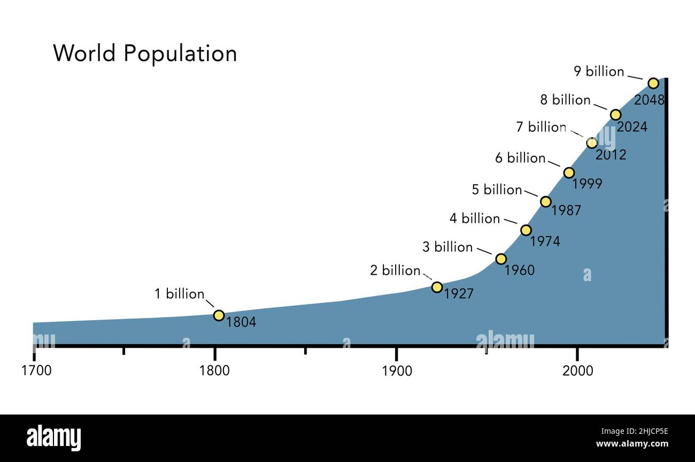
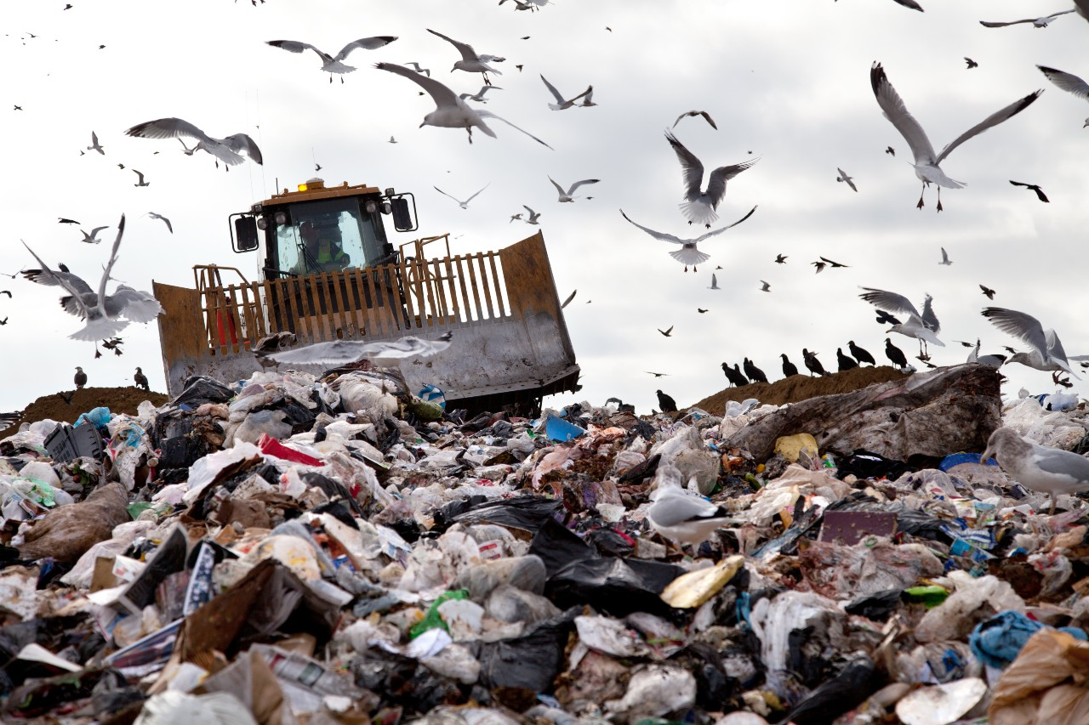
Need for Waste-to-Energy
Increasing population and industrialization have led to large quantities of waste. Waste-to-Energy (WTE) provides an effective solution for waste management while generating useful electricity.
Increasing population growth
Increasing industrial waste

Slide 4
Sources of Waste
1. Municipal Solid Waste (MSW)
2. Agricultural Waste
3. Industrial Waste
4. Plastic Waste
5. Biomass Waste

Slide 5
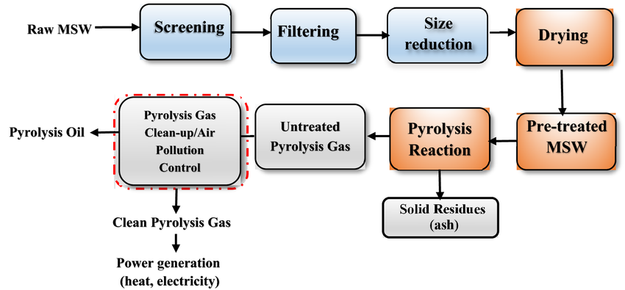
Concept of Waste-to-Energy
The concept is based on converting the chemical energy stored in waste materials into usable electrical energy using thermal, biological, or mechanical processes.

Slide 6
Method of Electricity Generation
1. Incineration
2. Gasification
3. Pyrolysis
4. Anaerobic Digestion
5. Landfill Gas Recovery

Slide 7
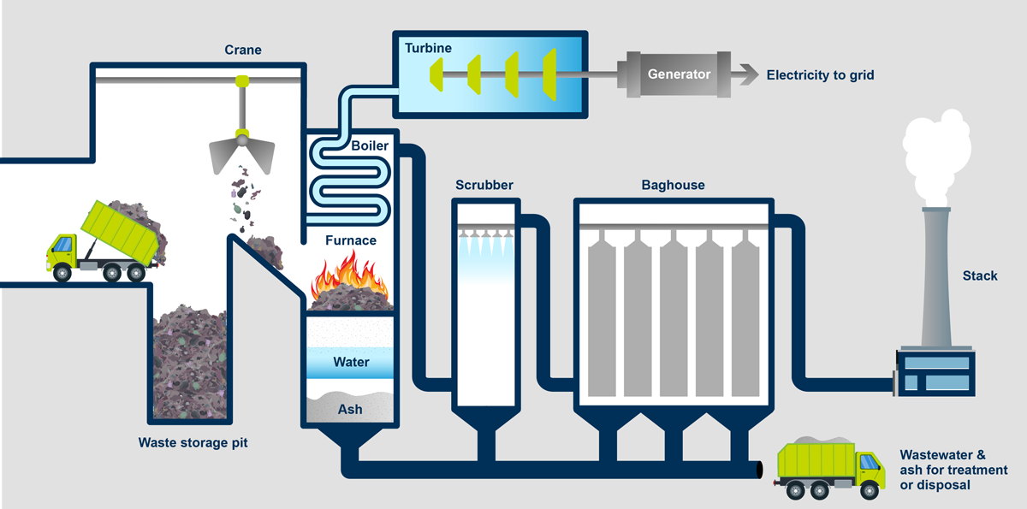
Incineration Process
Involves burning waste at high temperatures to produce heat, which is used to generate steam and drive turbines for electricity production.

Slide 8
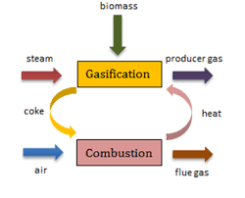
Gasification Process
Partial combustion of waste in limited oxygen produces syngas (CO + H2), which is used to drive gas turbines to produce electricity.

Slide 9
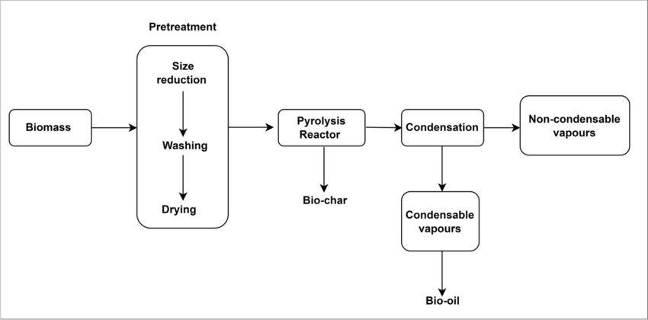
Pyrolysis Process
Thermal decomposition of organic waste materials at high temperatures in the absence of oxygen. Produces oil, gas, and char as useful by-products.

Slide 10
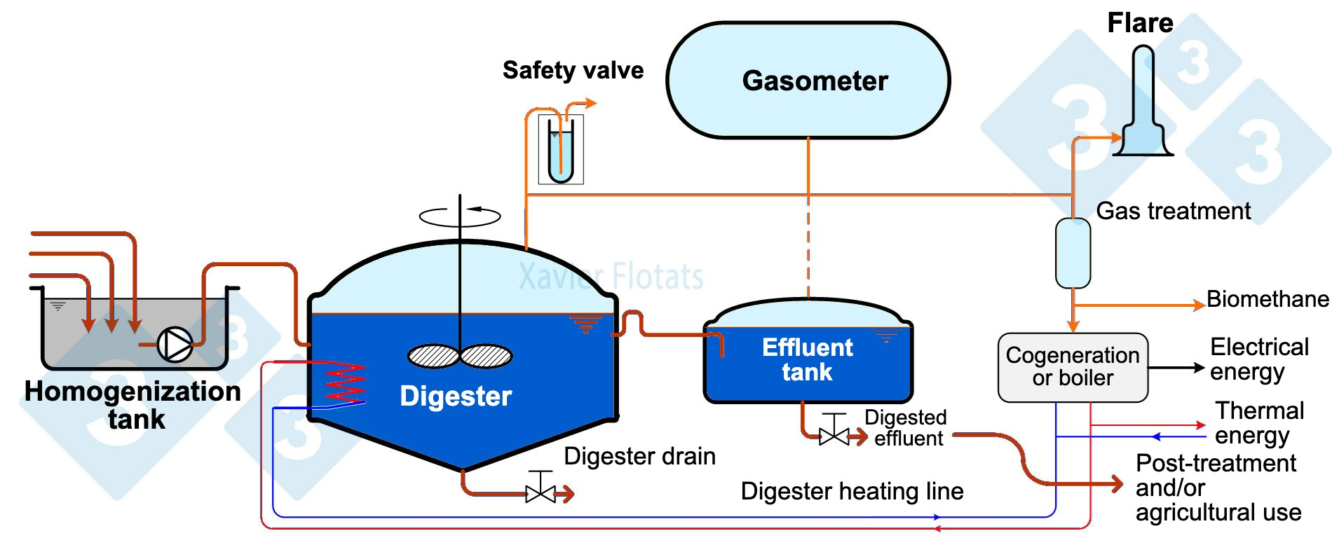
Anaerobic Digestion
Biological breakdown of organic waste by microorganisms in the absence of oxygen, producing biogas (mainly methane) used to generate power.

Slide 11
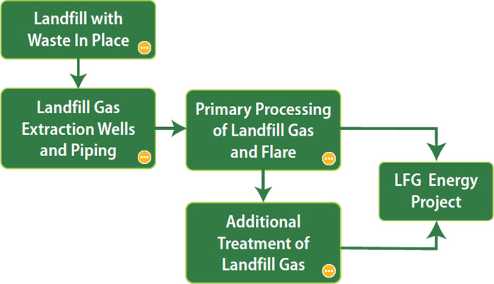
Landfill Gas Recovery
Methane produced from decomposing waste in landfills is collected and used as a fuel to generate electricity.

Slide 12
Block Diagram
The basic block diagram includes:
Waste collection
Segregation Transmission
Conversion process Power generation

Slide 13
Advantages
1. Reduces waste in landfills
2. Generates renewable energy
3. Reduces greenhouse gas emissions
4. Promotes sustainable waste management

Slide 14
Disadvantages
1. High initial cost
2. Requires waste segregation
3. Emits pollutants if not controlled properly
4. Complex technology management

Slide 15
Environmental Impact
Waste-to-Energy plants can reduce landfill waste and methane emissions, but require strict pollution control systems to minimize air contamination.

Slide 16
Future Scope
With advancements in technology and increased focus on renewable energy, WTE has a strong potential in the future energy mix of India.

Slide 17
Government Initiatives
Indian government has launched several programs under 'Swachh Bharat Mission' and 'Energy from Waste' policies to promote WTE projects.

Slide 18
Conclusion
Generation of electricity from waste is a sustainable and environmentally friendly solution to both waste disposal and energy production.

Slide 19
THANK YOU !

